Slide 1
CSE 12 – Basic Data Structures and Object-Oriented Design Lecture 13
Greg Miranda, Spring 2021
This lecture is being recorded

Slide 2

Announcements
Quiz 13 due Friday @ 12pm
PA4 due tonight @ 11:59pm
Survey 5 due Friday @ 11:59pm
PA5 released tomorrow (closed)

Slide 3
Topics
Partition/Sort
Questions on Lecture 13?

Slide 4

Quicksort: Another magical (recursive) algorithm
https://www.youtube.com/watch?v=ywWBy6J5gz8
14
4
9
12
15
8
19
2
Select a pivot element:
14
4
9
12
15
8
19
2
“Partition” the elements in the array (smaller or equal to pivot, larger or equal to pivot)
2
4
9
8
15
12
19
14
Magically sort the smaller elements and the larger elements (Quicksort)
2
4
8
9
12
15
19
21

Slide 5
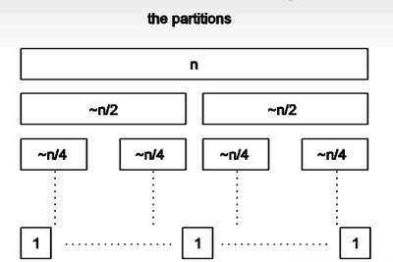

Quick Sort: Using a “good” pivot
How many levels will there be if you choose a pivot that divides the list in half?
1
log(N)
N
N*log(N)
N²

Slide 6

Quick Sort: Using a “good” pivot
If the time to partition on each level takes N comparisons, how long does Quicksort take with a good partition?
O(1)
O(log(N))
O(N)
O(N*log(N))
O(N²)

Slide 7







Which of these choices would be the worst choice for the pivot?
The minimum element in the list
The last element in the list
The first element in the list
A random element in the list

Slide 8
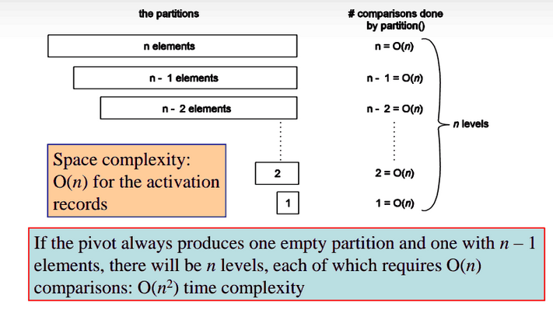
Quick sort with a bad pivot

Slide 9








Which of these choices is a better choice for the pivot?
The first element in the list
A random element in the list
They are about the same

Slide 10
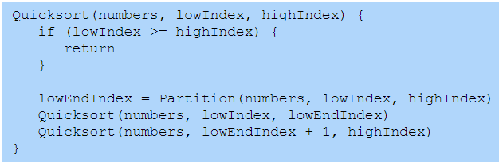
Quick sort – Middle Pivot
There are many ways to partition!
sort {12, 4, 9, 3, 15, 8, 19, 2}

Slide 11
Quick sort – Middle Pivot
We always pick the middle location as pivot
The data we sort is {2, 3, 1, 5, 4, 6, 7}
After the first split, what is the order of elements in the list that was <= pivot?
1 2 3 4
2 3 1 4
4 3 2 1
3 4 1 2
None of the above

Slide 12
QuickSort – Draw the picture of sort()
public class Sort {
public static void swap(String[] array, int i1, int i2) {
String temp = array[i1];
array[i1] = array[i2];
array[i2] = temp;
}
public static int partition(String[] array, int low, int high) {
int pivotStartIndex = high - 1;
String pivot = array[pivotStartIndex];
int smallerBefore = low, largerAfter = high - 2;
while (smallerBefore <= largerAfter) {
if (array[smallerBefore].compareTo(pivot) < 0) {
smallerBefore += 1;
}
else {
swap(array, smallerBefore, largerAfter);
largerAfter -= 1;
}
}
swap(array, smallerBefore, pivotStartIndex);
return smallerBefore;
}
public static void qsort(String[] array, int low, int high) {
if (high - low <= 1) { return; }
int splitAt = partition(array, low, high);
qsort(array, low, splitAt);
qsort(array, splitAt + 1, high);
}
public static void sort(String[] array) {
qsort(array, 0, array.length);
}
main() {
String[] str = {"f", "b", "a", "e", "d", "c" };
int[] result = Sort.sort(str);
System.out.println(Arrays.deepToString(result));
}

